Slide 1

DEVELOPMENT LIFECYCLE &
AGILE TECHNIQUES
LESSON 10 - WORKSHOP
NANODEGREE → FOUNDATION MODULE
Notes:
[Opening slide]

Slide 2

AGENDA
01 Introduction to SDLC
02 SDLC Methodology
03 Scrum
04 Scrum Board Demo
05 Scrum Retro group exercise

Slide 3

SDLC
SOFTWARE DEVELOPMENT LIFECYCLE
7
1
MAINTAIN
PLAN
6
DEPLOY
2
REQUIREMENTS
5
TEST & INTEGRATE
3
DESIGN
4
IMPLEMENT
Notes:
TALKING POINTS
Software Development Life Cycle (SDLC) is a terminology used to explain how software is delivered to a customer in a series of steps.
These steps take software from the ideation phase to delivery.
The process of software development is a never-ending cycle. The first release of a software application is rarely “finished.”
There are almost always additional features and bug fixes waiting to be designed, developed, and deployed.
These steps are (very) roughly the same from one methodology to another.
They tend to occur in this order, though they can also be mixed together, such that several steps occur in parallel.
As we’ll discuss later, Agile methods tend to “wind together” all of these steps into a tight, rapidly-repeating cycle. Outputs from one become inputs to the following step.

Slide 4

PLANNING
SDLC
Notes:
TALKING POINTS
1. Planning
The planning phase involves aspects of project and product management. This may include:
Resource allocation (both human and materials)
Capacity planning
Project scheduling
Cost estimation
Provisioning
The outputs of the planning phase include: project plans, schedules, cost estimations, and procurement requirements. Ideally, Project Managers and Development staff collaborate with Operations and Security teams to ensure all perspectives are represented.

Slide 5

REQUIREMENTS
SDLC
Notes:
TALKING POINTS
1. Requirements
The business must communicate with IT teams to convey their requirements for new development and enhancement. The requirements phase gathers these requirements from business stakeholders and Subject Matter Experts (SMEs.)
Architects, Development teams, and Product Managers work with the SMEs to document the business processes that need to be automated through software.
The output of this phase in a Waterfall project is usually a document that lists these requirements. Agile methods, by contrast, may produce a backlog of tasks to be performed. ---> SAY THAT WE WOULD DISCUSS Waterfall and Agile in more detail in a moment.

Slide 6

REQUIREMENTS
Grab a pen and some paper
GROUP EXERCISE
Notes:
TALKING POINTS
Ask students to draw a house, you can mention the high level details like:
It needs to have a square front with one window and a door
Trapeze roof with a chimney
Left hand side of the house is a one storey extension with to windows
At the end of the extension there is a square turret tower with two narrow rectangular windows
Right side of the house there is a tree
We have a path that leads to the front door.

Slide 7
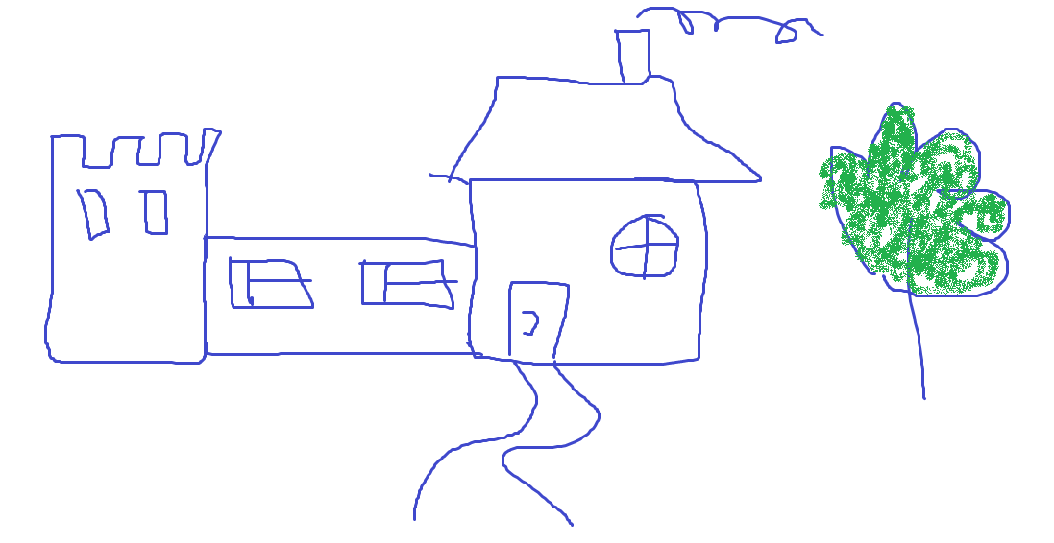
Notes:
This is the house WE HAD in mind
Ask students to compare their drawings to our one

Slide 8

REQUIREMENTS
CAPTURING TECHNIQUES EXAMPLES
VISUAL
Wireframe
Blueprint
FUNCTIONAL
AS / WHEN / THEN technique
Manual example document
Notes:
AS <Role> (e.g. AS Developer)
WHEN <Action> (e.g. WHEN I pass a trade ID to the DB engine function and execute a query)
THEN <Result> (e.g I get back a trade record in the form of a dictionary with all trade details captured as key:value pairs.)

Slide 9

DESIGN
SDLC
Notes:
TALKING POINTS
3. Design
Once the requirements are understood, software architects and developers can begin to design the software. The design process uses established patterns for application architecture and software development.
Developers use proven Design Patterns to solve algorithmic problems in a consistent way. This phase may also include some rapid prototyping, also known as a spike, to compare solutions to find the best fit. Teams can run whiteboard sessions to outline system flow or architecture together. The output of this phase includes:
Design documents that list the patterns and components selected for the project
Code produced by spikes, used as a starting point for development

Slide 10




EXAMPLE 1
EXAMPLE 2
DB
YES / NO
DB
BACK END LOGIC
BACK END LOGIC

Slide 11

IMPLEMENT SOFTWARE
SDLC
Notes:
TALKING POINTS
Software Development
This phase produces the software under development.
Depending on the methodology, this phase may be conducted in time-boxed “sprints,” (Agile) or may proceed as a single block of effort (Waterfall.)
Regardless of methodology, development teams should produce working software as quickly as possible.
Business stakeholders should be engaged regularly, to ensure that their expectations are being met. The output of this phase is testable, functional software.

Slide 12

TESTING
SDLC
Notes:
TALKING POINTS
5. Testing
The testing phase of the SDLC is arguably one of the most important. It is impossible to deliver quality software without testing. There is a wide variety of testing necessary to measure quality:
Code quality
Unit testing (functional tests)
Integration testing
Performance testing
Security testing
The best way to ensure that tests are run regularly, and never skipped for expediency, is to automate them. The output of the testing phase is functional software, ready for deployment to a production environment.

Slide 13

Dev
UAT
<code>
<code>
QA
Prod
<code>
Notes:
Code quality
Unit testing (functional tests)
Integration testing
Performance testing
Security testing

Slide 14

DEPLOYMENT
SDLC
Notes:
TALKING POINTS
6. Deployment
The deployment phase is, ideally, a highly automated phase. In high-maturity enterprises, this phase is almost invisible; software is deployed the instant it is ready. Enterprises with lower maturity, or in some highly regulated industries, the process involves some manual approvals. However, even in those cases it is best for the deployment itself to be fully automated in a continuous deployment model.
Application Release Automation (ARA) tools are used in medium and large-size enterprises to automate the deployment of applications to Production environments. ARA systems are usually integrated with Continuous Integration tools. The output of this phase is the release to Production of working software.

Slide 15
Dev
<code>
UAT
<code>
Prod
Release Process
Change Request
Deployment
<code>
QA
<code>

Slide 16

MAINTENANCE
SDLC
Notes:
TALKING POINTS
7. Maintenance
The operations and maintenance phase is the “end of the beginning,” so to speak.
The Software Development Life Cycle doesn’t end here. Software must be monitored constantly to ensure proper operation.
Bugs and defects discovered in Production must be reported and responded to, which often feeds work back into the process. Bug fixes may not flow through the entire cycle, however, at least an abbreviated process is necessary to ensure that the fix does not introduce other problems (known as a regression.)

Slide 17
METHODOLOGIES
SDLC
Agile
Lean
Waterfall
Iterative
Spiral
DevOps
Agile
Waterfall
Notes:
TALKING POINTS
We focus on 2 commonly used.
Encourage students to research the other methodologies in their own time.

Slide 18
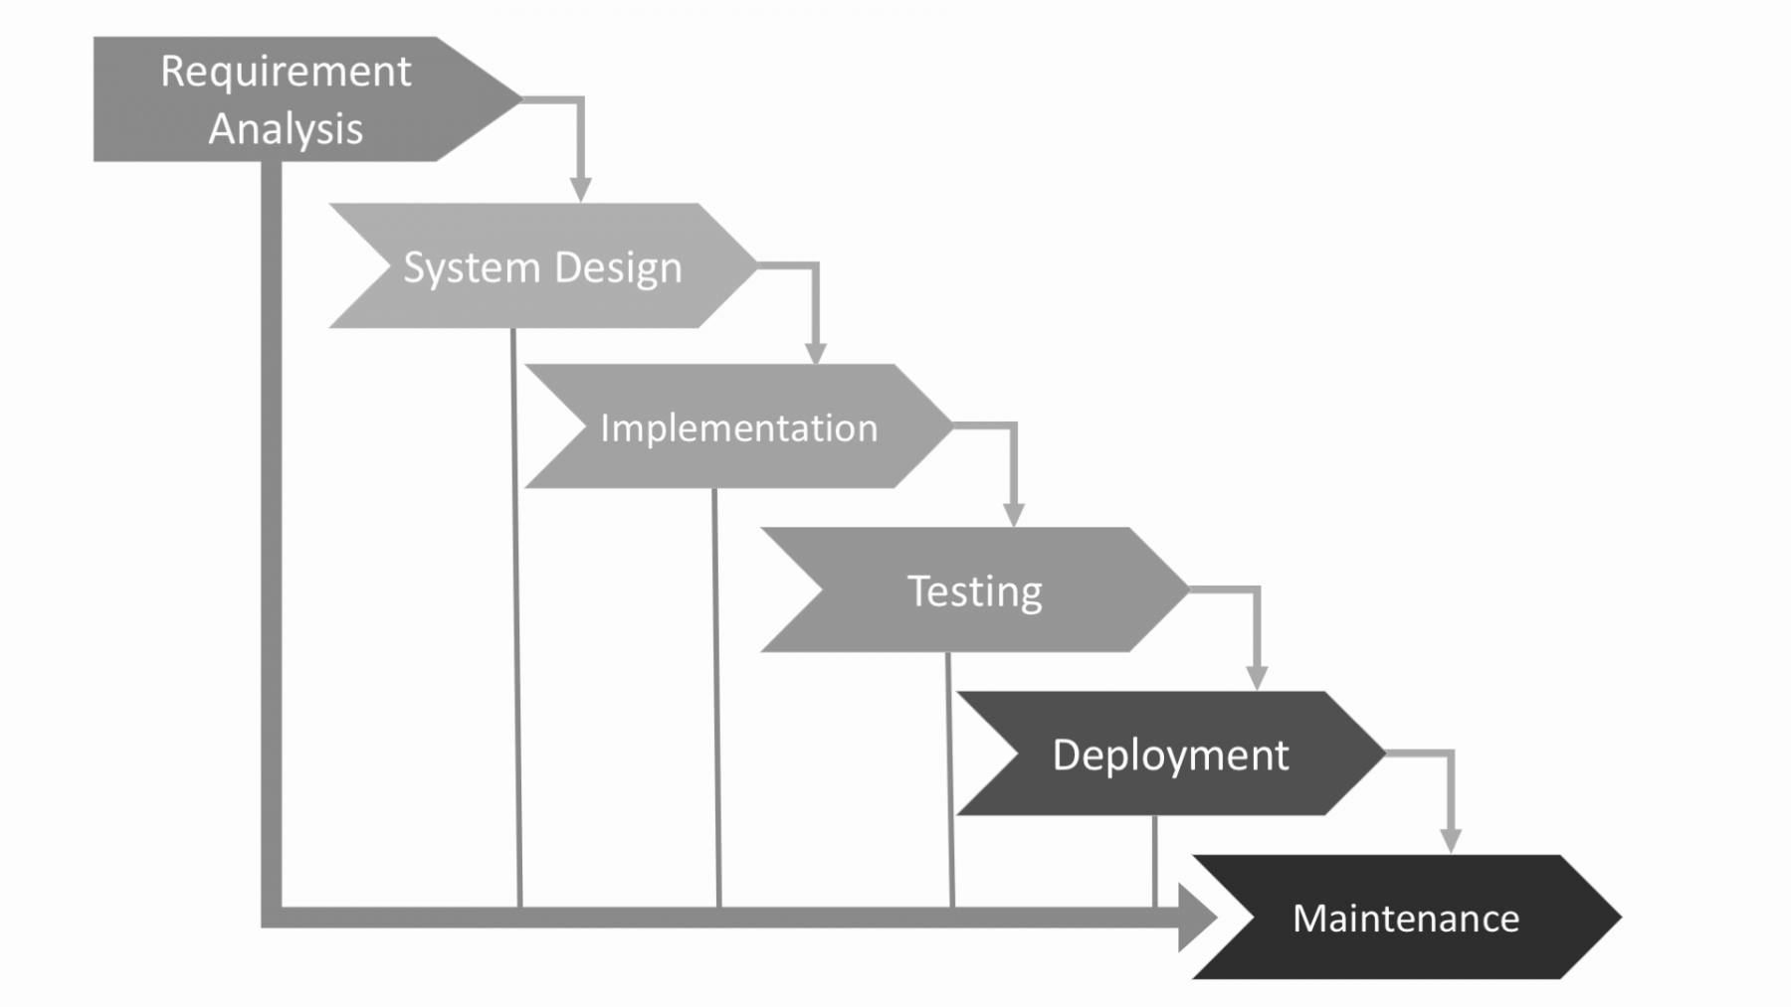
WATERFALL
SDLC
Notes:
TALKING POINTS
Waterfall – is a cascade SDLC model, in which development process looks like the flow, moving step by step through the phases of analysis, projecting, realization, testing, implementation, and support.
This SDLC model includes gradual execution of every stage completely. This process is strictly documented and predefined with features expected to every phase of this software development life cycle model.
Use cases for the Waterfall SDLC model:
The requirements are precisely documented
Product definition is stable
The technologies stack is predefined which makes it not dynamic
No ambiguous requirements
The project is short

Slide 19
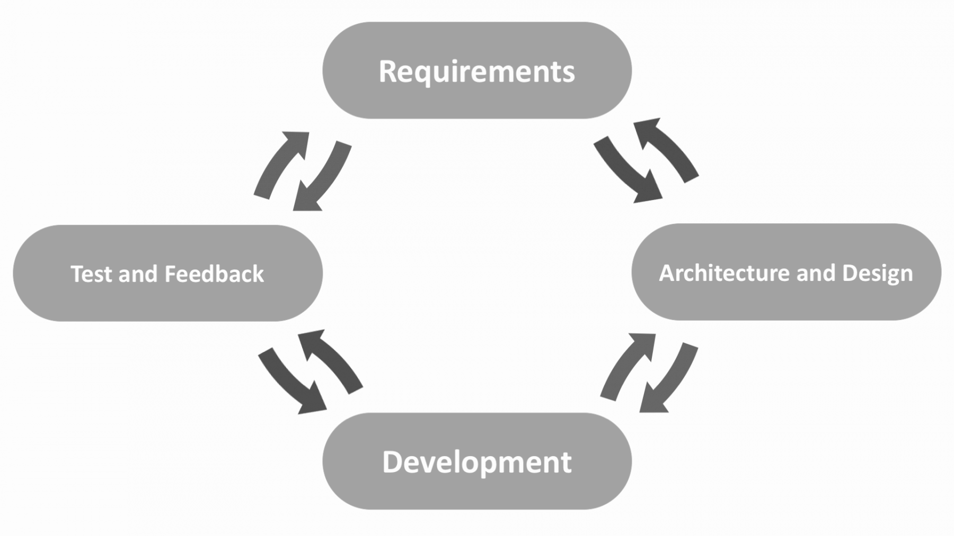
AGILE
SDLC
Notes:
TALKING POINTS
In the agile methodology after every development iteration, the customer is able to see the result and understand if he is satisfied with it or he is not. This is one of the advantages of the agile software development life cycle model.
One of its disadvantages is that with the absence of defined requirements it is difficult to estimate the resources and development cost. Extreme programming is one of the practical use of the agile model. The basis of such model consists of short weekly meetings – Sprints which are the part of the Scrum approach.
Use cases for the Agile model:
The users’ needs change dynamically
Less price for the changes implemented because of the many iterations
Unlike the Waterfall model, it requires only initial planning to start the project

Slide 20
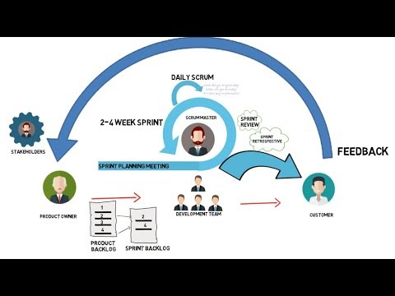
SCRUM
VIDEO
Notes:
TALKING POINTS
This is 3 min video about scrum.

Slide 21
SCRUM BOARD
AGILE METHODOLOGY
Let’s learn how to create our own Scrum Board!
DEMO
Notes:
TALKING POINTS
Design your own SCRUM BOARDS (it is up to you which one to use):
Use http://scrumblr.ca/ ---> better suited for a MOOC

Slide 22
RETROSPECTIVE
AGILE METHODOLOGY
Let’s learn how to run our own Retrospective meeting!
GROUP EXERCISE
Notes:
TALKING POINTS
Design your own Retro board
Use https://reetro.io/
Share the link with the group and encourage them to write down their own ideas.

Slide 23
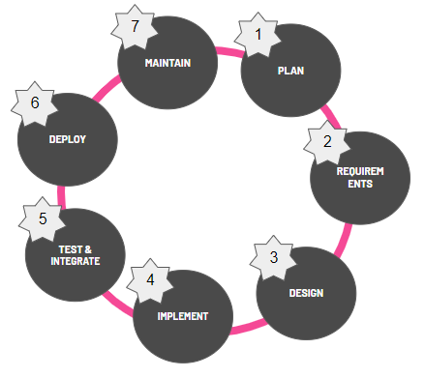
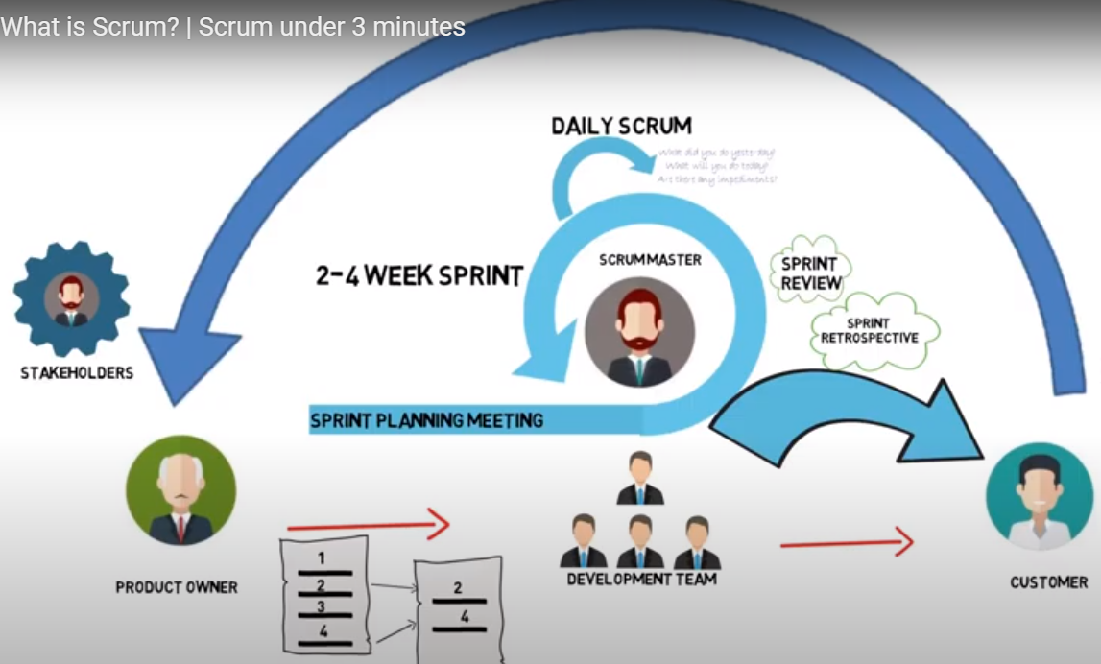
SUMMARY
KEY TAKEAWAYS
Notes:
TALKING POINTS
Recap on the cycle
Environments
Scrum
It would be good to recommend students to explore these 3 areas more to be very comfortable with these definition.

Slide 24
THANK YOU!

